Slide 1
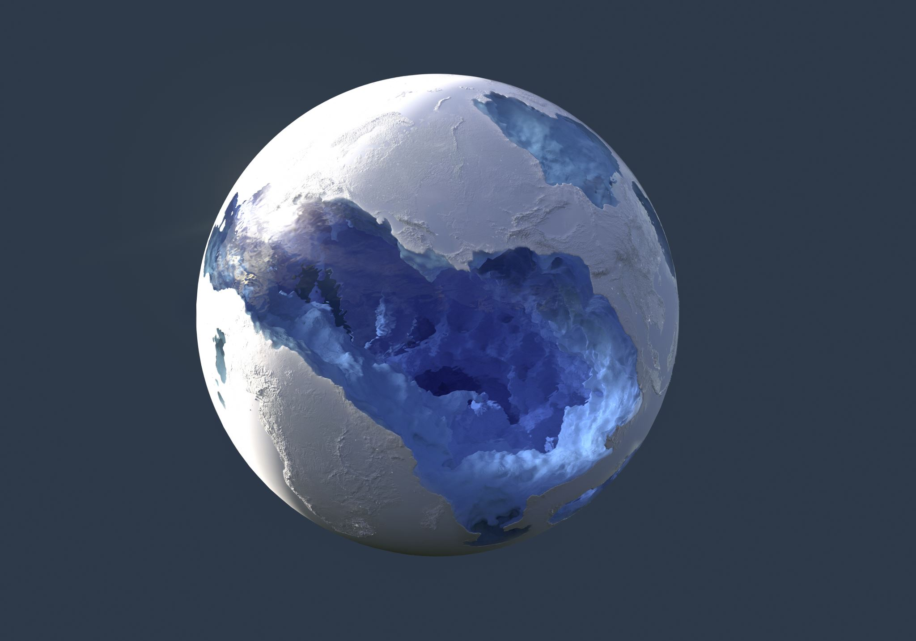
Global Earthquakes (2024–2025): Map & Aggregation Visualizations
CSIT 553 – Exploratory Data Analysis & Visualization – Project 2
Prepared by:
Ayush Saxena Shrivastava
Dhir Rameshbhai Panchal
Vishwa Vimalkumar Patel
Keerthi Santoshini Nancherla

Slide 2
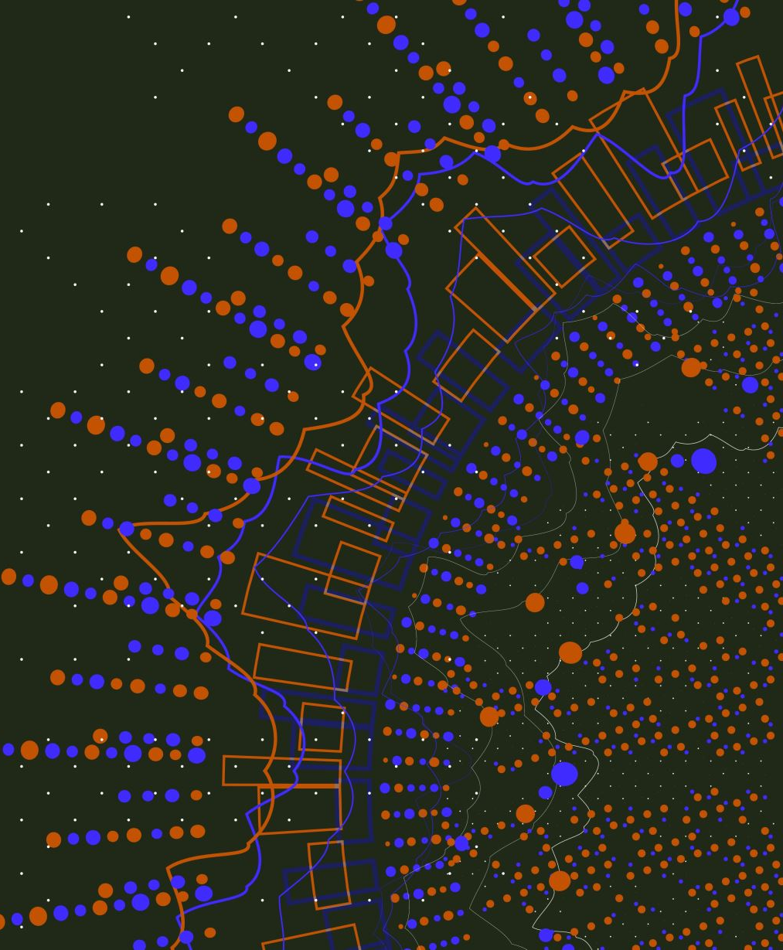
Project Description & Data Set
Project Title: Global Earthquake Analysis (2024-2025)
Project Objective: The primary objective of this project is to explore and visualize global earthquake data to identify patterns in frequency, magnitude, and depth. By utilizing various visualization techniques, we aim to understand the distribution of seismic activities and the relationship between different earthquake characteristics.
Data Source: The dataset was obtained from the United States Geological Survey (USGS) Earthquake Catalog.
URL: https://earthquake.usgs.gov/earthquakes/search/
Data Description: The dataset includes records of earthquakes occurring between 2024 and 2025. Key features include:
time: The date and time of the event.
latitude & longitude: The geographical coordinates of the epicenter.
depth: The depth of the earthquake in kilometers.
mag: The magnitude of the earthquake.
magType: The method or algorithm used to calculate the preferred magnitude (e.g., mb, mww, ml).
place: A textual description of the location (e.g., "27 km NW of Āwash, Ethiopia").
status: Indicates whether the event has been reviewed by a human or is an automatic system result.

Slide 3
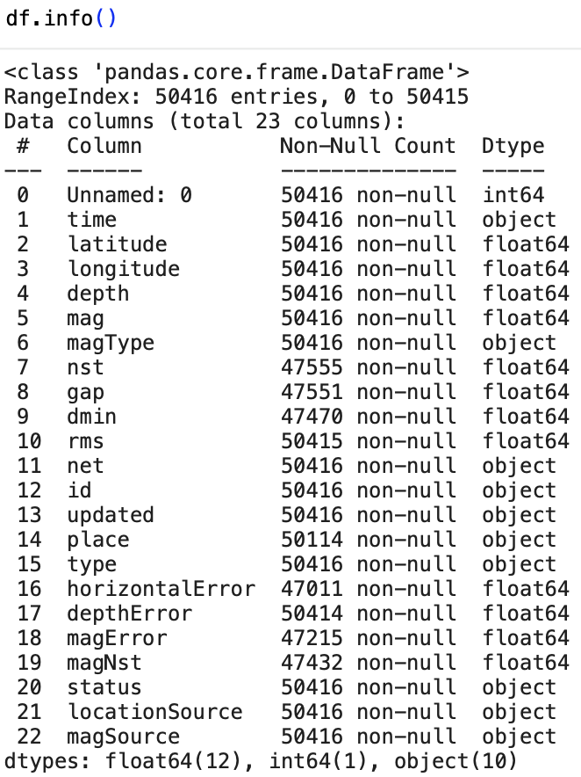
Data Loading & Cleaning:
The data was loaded into a Pandas DataFrame from a CSV file.
The time column was converted to datetime objects for time-series analysis.
A new Country column was extracted from the place string to facilitate regional analysis.
We filtered for relevant columns and handled potential missing values in magnitude or depth to ensure accurate plotting.

Slide 4
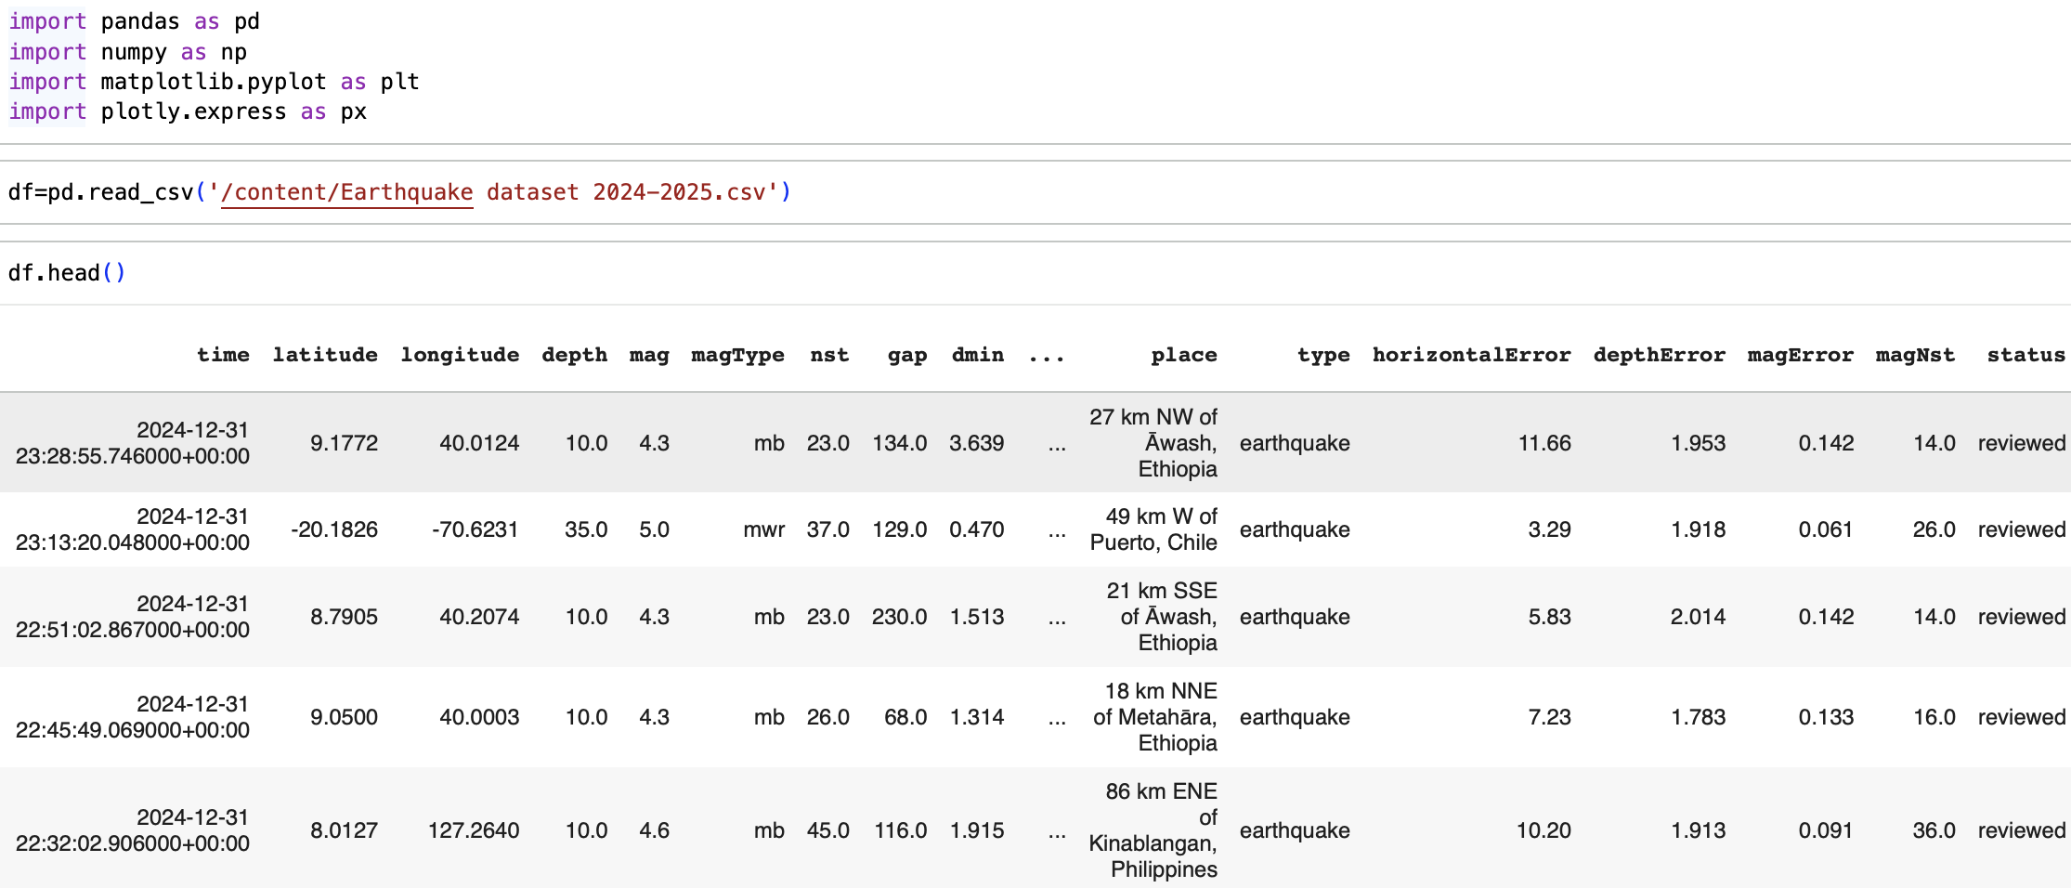
Data Loading

Slide 5
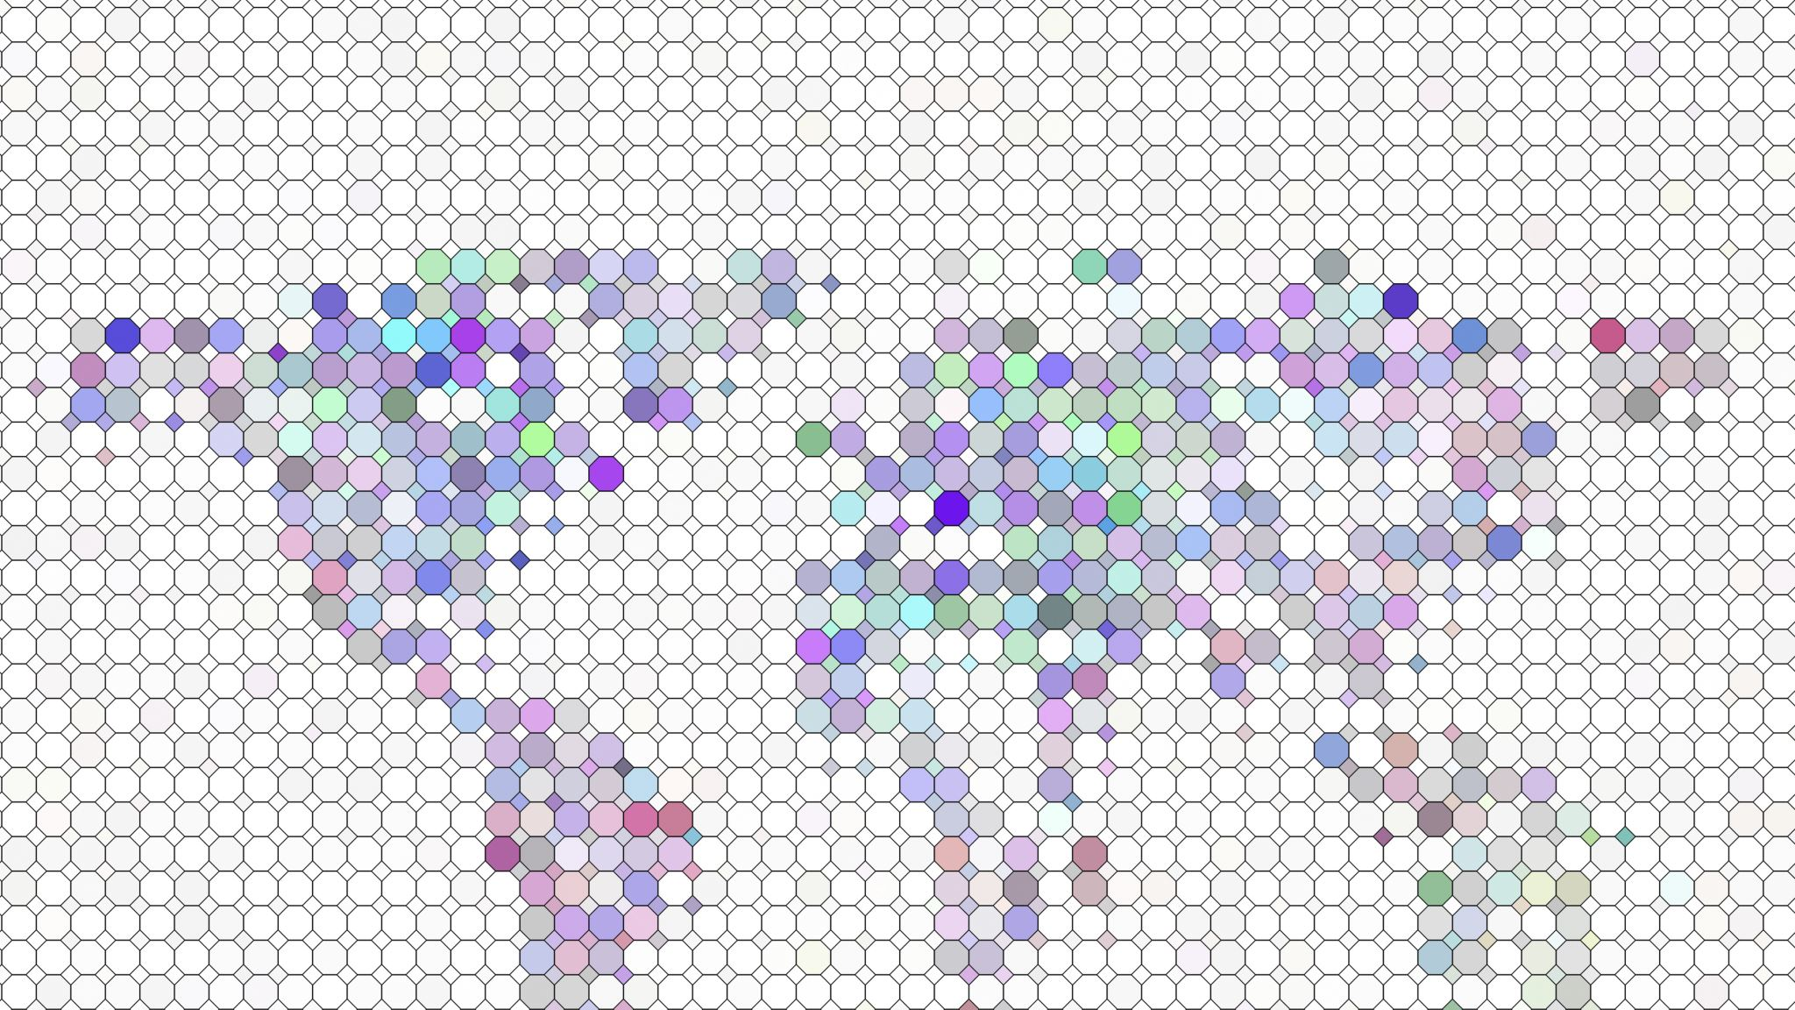
Map Visualization

Slide 6
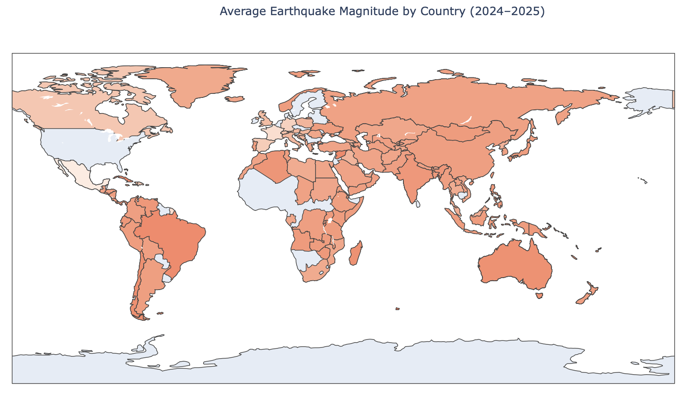
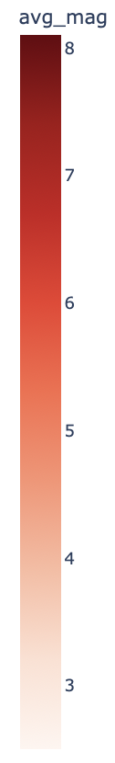
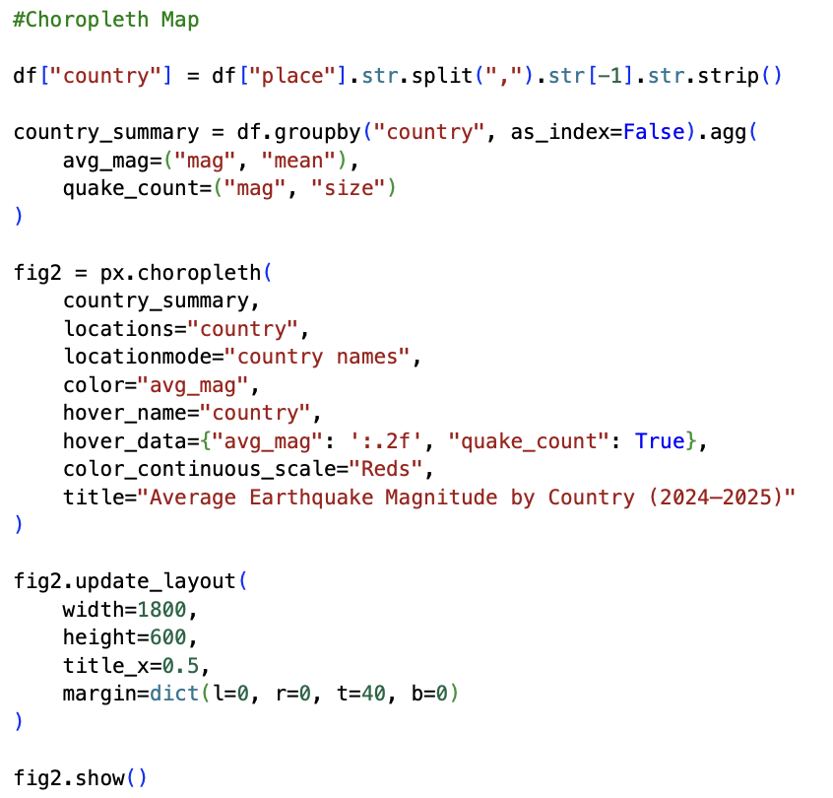
Choropleth Map
Data Preparation: The place column was processed to extract the country name for each earthquake record. We then aggregated the data to calculate the total count of earthquakes per country.
Encoding:
Locations: Countries (mapped by name).
Color: The color intensity represents the Frequency (Count) of earthquakes in that country. Darker colors indicate a higher number of recorded seismic events.
Observation: This visualization provides a high-level geopolitical view of seismic activity. It clearly identifies which nations are most affected by earthquakes (e.g., Indonesia, Chile, Japan, USA), highlighting the correlation between national borders and tectonic plate boundaries.

Slide 7
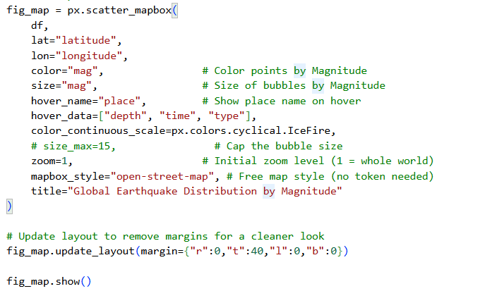
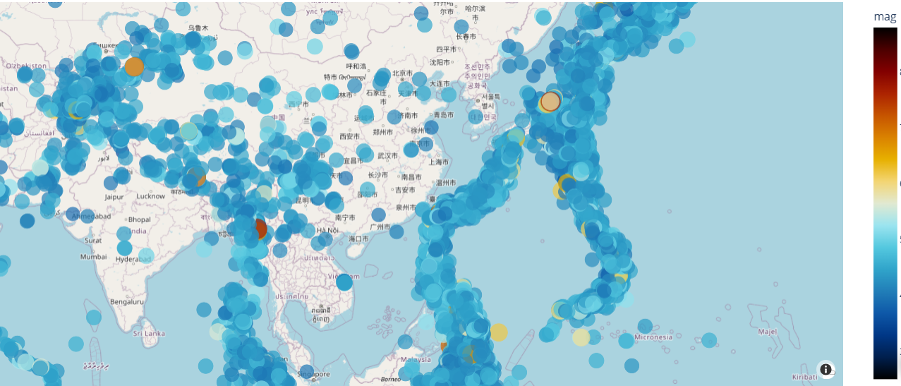
Bubble Map
Encoding:
Location: Mapped using Latitude and Longitude coordinates.
Size: The size corresponds to Magnitude (mag). Larger bubbles indicate stronger quakes.
Color: The color also represents Magnitude (using the IceFire scale). This "double encoding" (using both size and color for the same data) creates a strong visual emphasis on the most powerful earthquakes.
Interactivity:
Pan & Zoom: Users can freely navigate the global map to examine specific regions in detail.
Hover: Hovering over a bubble reveals the exact place name, depth, time, and event type.
Observation:
This visualization uses an OpenStreetMap background for detailed geographic context. The distribution clearly outlines major tectonic plate boundaries (the "Ring of Fire"). By mapping Magnitude to both size and color, the most significant seismic events become the immediate focal point of the dashboard.

Slide 8
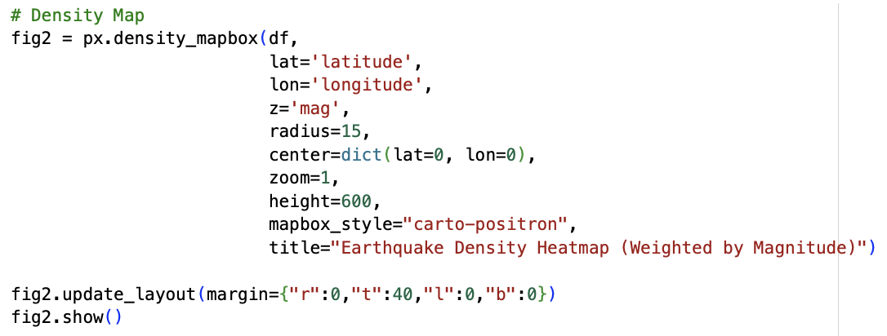
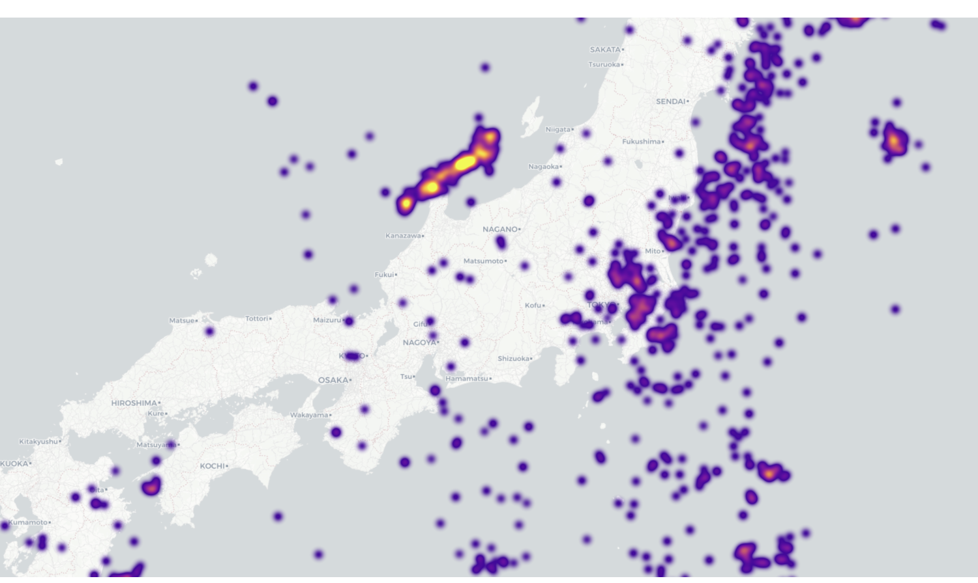
Density Map (Heatmap)
Encoding:
Location: Latitude and Longitude.
Intensity: The "heat" or intensity of the color represents the density of earthquake occurrences in that area, weighted by their Magnitude. Areas with many overlapping or high-magnitude earthquakes appear as "hot" spots (red/yellow).
Interactivity:
Dynamic Radius: As the user zooms in, the density calculation adjusts to the visible area, allowing for analysis at both global and local scales.
Observation: Unlike the bubble map which shows individual events, the density map highlights zones of high activity. It effectively removes the noise of individual small quakes and focuses on regions with the highest release of seismic energy, such as the boundaries of the Pacific Plate.

Slide 9

2. Aggregation Visualization

Slide 10
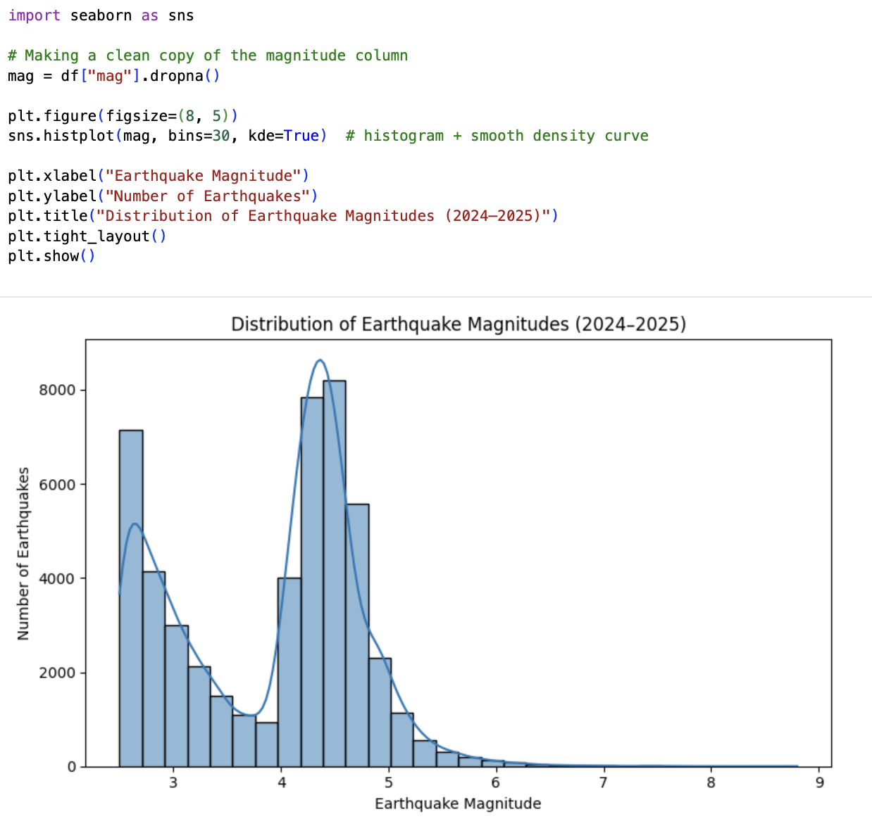
Histogram of Earthquake Magnitudes
Description: A histogram displays the frequency distribution of earthquake magnitudes. The X-axis represents the magnitude (binned), and the Y-axis shows the count of earthquakes falling into each bin.
Observation: This plot typically reveals a "power law" distribution (Gutenberg-Richter law), where smaller earthquakes are extremely frequent, while larger magnitudes (>5.0) are rare. It provides a clear overview of the seismic activity levels in the dataset.

Slide 11
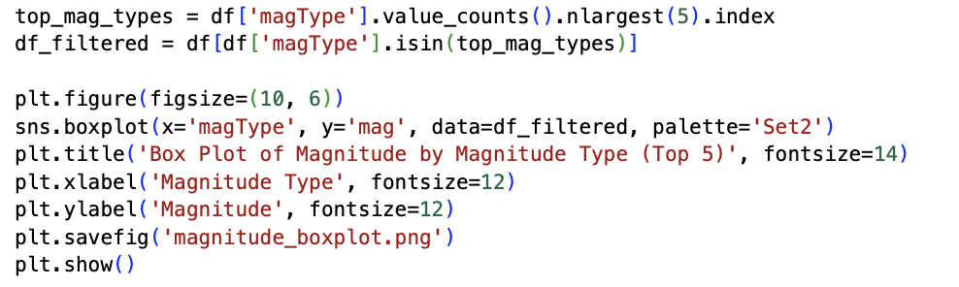
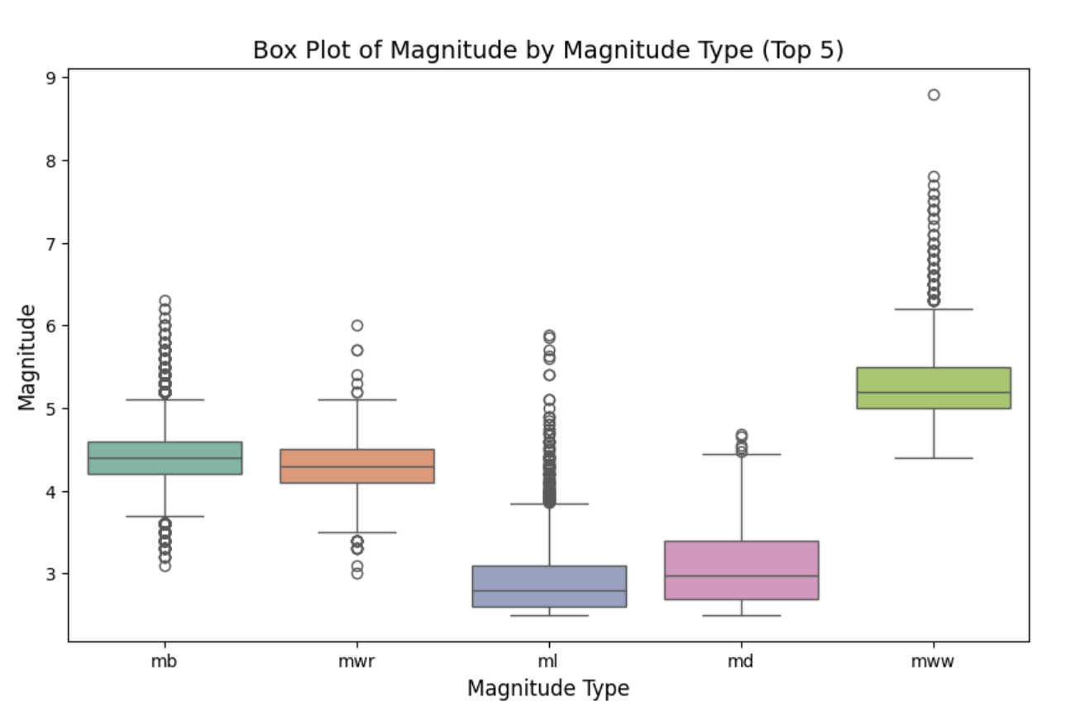
Box Plot of Depth by Magnitude Type
Description: A box plot compares the distribution of earthquake depths across different magnitude measurement types (magType).
Observation: This visualization helps us understand if certain magnitude scales are associated with deeper or shallower events. For example, mww (Moment Magnitude) is often calculated for larger, deeper earthquakes, while ml (Local Magnitude) might capture shallower, crustal events. The box plot clearly shows the median depth and outliers for each category.
Top 5 magnitude types in our dataset:
• mb – Body-wave magnitude based on short-period from distant stations.
• mwr – Regional moment-magnitude estimated from regional-distance waveforms.
• ml – Local (Richter) magnitude, used for nearby small–moderate earthquakes.
• md – Duration magnitude, based on how long the shaking signal lasts on the seismogram. .
• mww – Moment magnitude, often used for larger global events.

Slide 12

Interactive Visualization

Slide 13
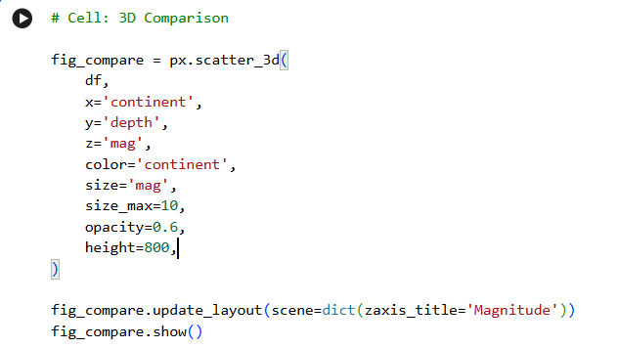
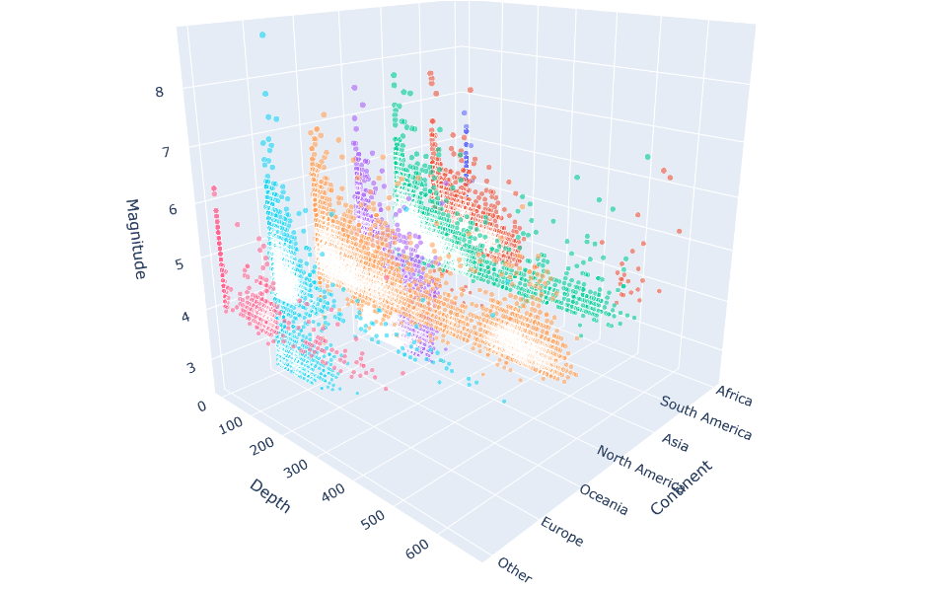
3D Tectonic Analysis (Depth vs. Magnitude)
Encoding:
Axes:
X-Axis: Represents the Continent (Categorical).
Y-Axis: Represents earthquake Depth (in km).
Z-Axis: Represents Magnitude (Intensity), giving vertical height to stronger events.
Visual Cues:
Color: Distinct colors identify different continents, allowing for immediate visual comparison of their seismic profiles.
Size: Bubble size is scaled by Magnitude, reinforcing the Z-axis data for emphasis.
Interactivity:
3D Rotation: The primary feature is the ability to rotate the plot 360 degrees. This allows the user to look "behind" the data points to see if deep earthquakes (high Y-value) are also the strongest (high Z-value).
Zoom: Users can zoom into specific clusters to inspect dense seismic zones.
Key Insight:
This visualization moves beyond simple mapping to analyze structural differences between continents. By plotting Depth against Magnitude in 3D space, we can test hypotheses such as: "Do deeper earthquakes tend to be weaker?" or "Does one continent have significantly deeper seismic activity than another?" (e.g., comparing subduction zones).

Slide 14
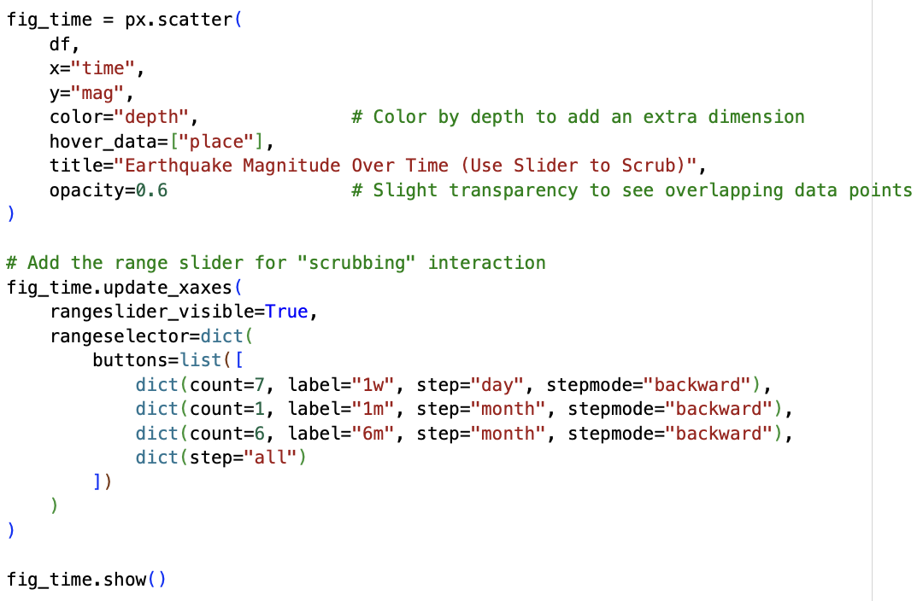
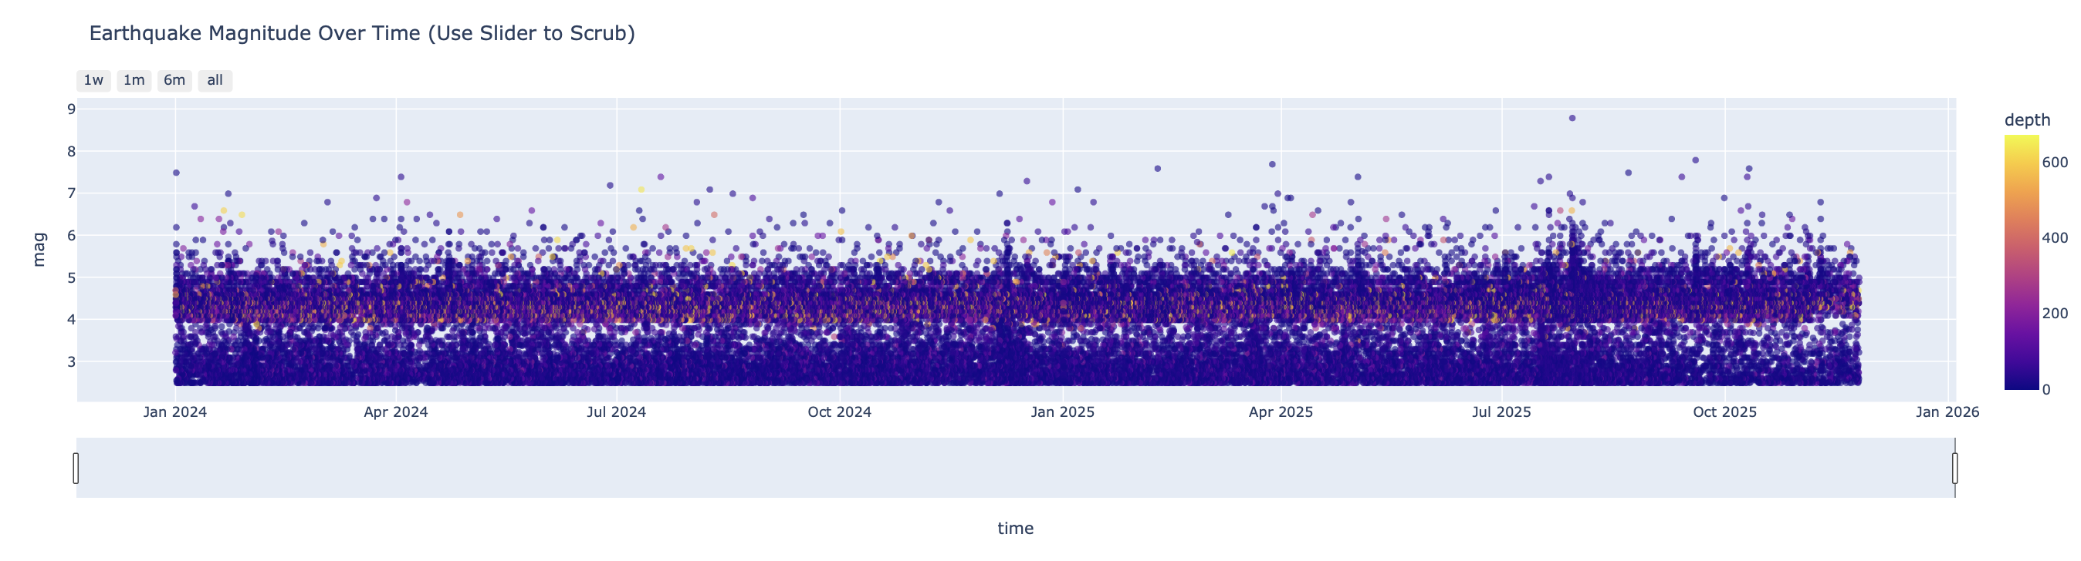
Time-Series with Scrubbing
Description: An interactive scatter plot showing earthquakes over time. The X-axis is Time, and the Y-axis is Magnitude. The points are colored by Depth.
Interactivity: A Range Slider at the bottom allows users to "scrub" and select specific time windows (e.g., zooming in on a specific month or week). Hovering over a point displays the exact location and time.
Observation: This tool is powerful for identifying temporal clusters or "swarms" of earthquakes and seeing if a large event was followed by a series of aftershocks.

Slide 15
Conclusion
Frequency Patterns: The analysis confirms that low-magnitude earthquakes are vastly more common than high-magnitude ones.
Depth Correlations: Different magnitude types tend to capture earthquakes at different depth ranges, highlighting the importance of using specific scales for deep vs. shallow tectonic analysis.
Temporal Clustering: Seismic activity is not perfectly uniform; the interactive time-series reveals distinct bursts of activity, likely corresponding to major seismic events and their subsequent aftershocks.

